Slide 1
Facade Design Pattern
CS5551 - Team 11
Cameron L’Ecuyer – Class ID: 17
Ruthvic Punyamurtula – Class ID: 30
Navya Pillala – Class ID: 26
Sneha Mishra – Class ID: 21

Slide 2
Facade Design Pattern
Structural Design Pattern
Used to simplify a client applications interface
Primary use is to provide a unified interface for a set of subsystems that a program may have due to increasing feature size
Acts as a wrapper for subsystems

Slide 3
Facade Design Pattern (cont’d)
Subsystems should not know about it, and it should be fairly simple in nature
It is more useful as interfaces grow and become more complex, but it can be used at any time in development
By using Facade with the Factory Pattern, we can improve client-side interfaces

Slide 4
Use of Facade Pattern
Suppose you have a system composed of multiple types of databases, and you want to be able to output the data in HTML, PDF, TXT, and DOC files
You can have an interface for every different database, or you can leverage the Facade Pattern to use a unified interface on top of the individual systems

Slide 5
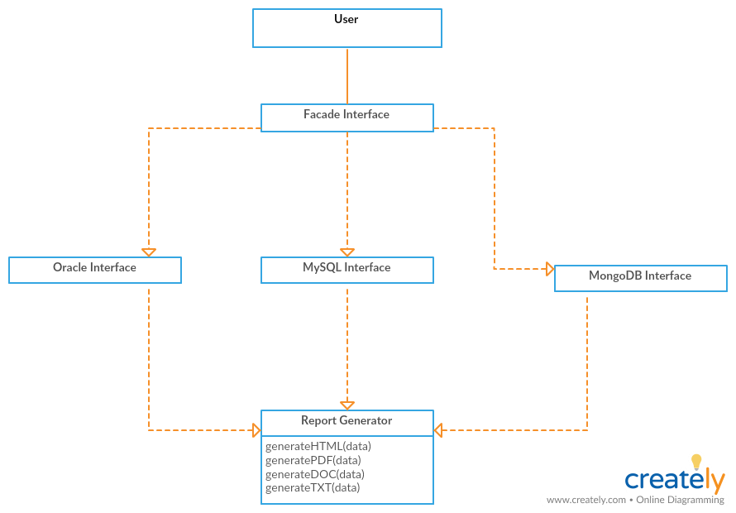
UML

Slide 6
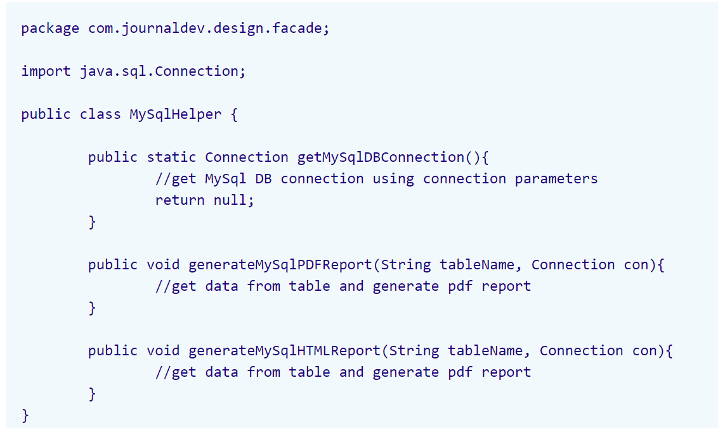
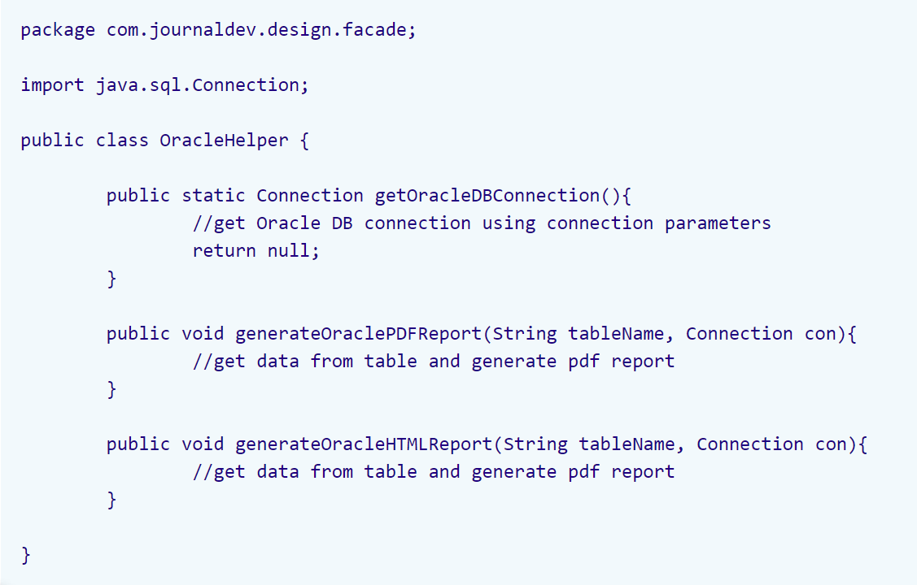
Code - Interfaces
Code From: https://www.journaldev.com/1557/facade-design-pattern-in-java

Slide 7
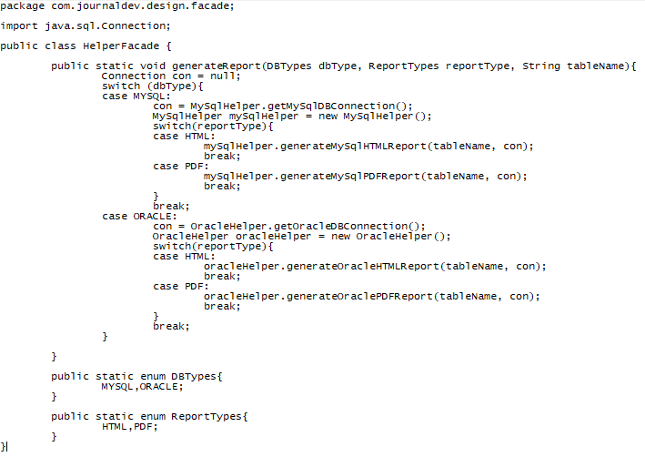
Code

Slide 8
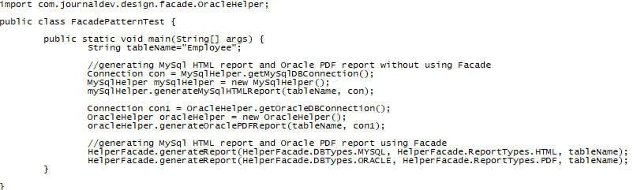
Code (cont’d)

Slide 9
Questions
When can you use Facade in development?
Should subsystems know about the Facade interface?
What pattern can it be coupled with for better client-side UI’s?

Slide 10
Bibliography
https://sourcemaking.com/design_patterns/facade
https://www.journaldev.com/1827/java-design-patterns-example-tutorial#facade-pattern
https://www.journaldev.com/1557/facade-design-pattern-in-java

